Slide 1
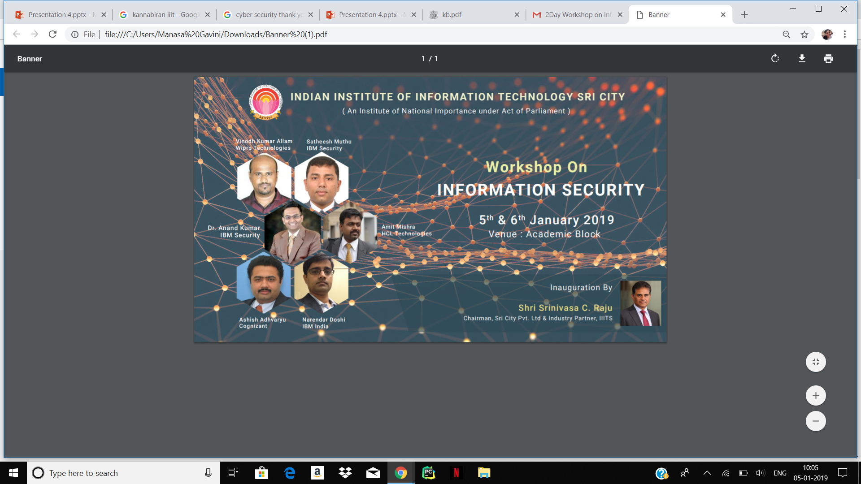

Slide 2






Cyber Security Workshop

Slide 3
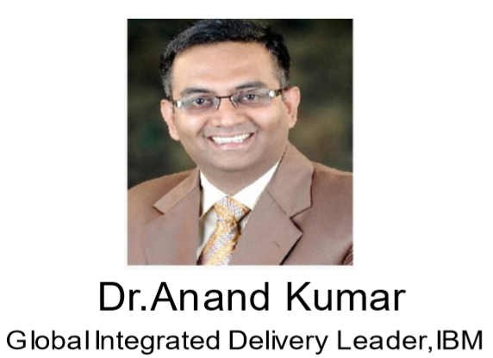
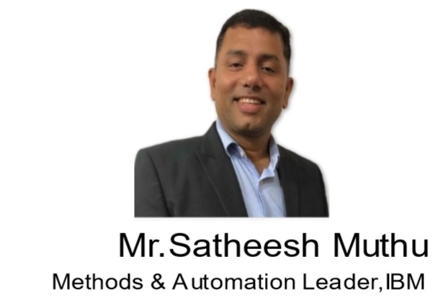
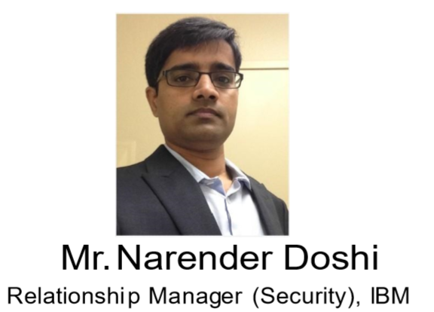
Panelists

Slide 4
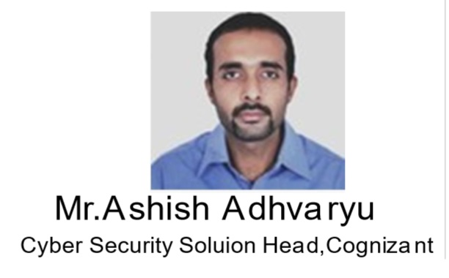
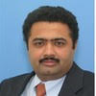
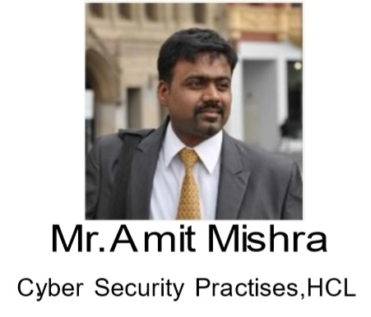
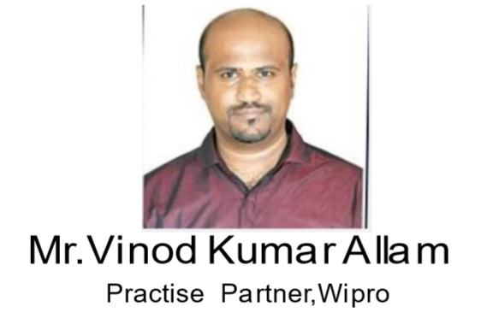
Panelists

Slide 5
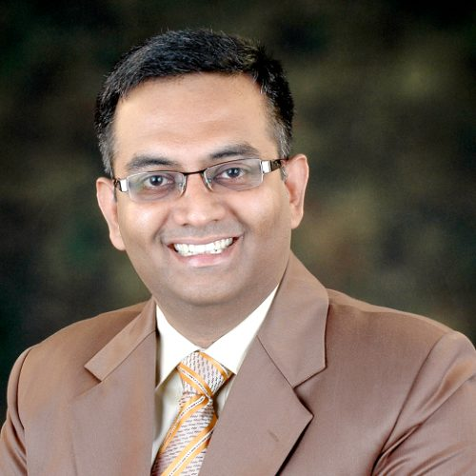
Dr. Ananda Kumar
Dr. Ananda Kumar is the Global Integrated Delivery (GID) leader at IBM Security Services. He has 20 years of experience in the IT & IT Security Services industry working with large global organizations. Prior to joining IBM, he was the General Manager and head of global delivery at Wipro Cybersecurity and Risk Services where he was the recipient of the CEO award twice. He is the recipient of the prestigious Chevening fellowship from the UK Foreign and Commonwealth Office.

Slide 6
Mr. Narender Doshi
Mr. Narender Doshi is the Relationship Manager for IBM Security, Global Integrated Delivery.
He has more than 18 years of IT experience with more than 14 years in Information Security. Prior to IBM, Narendar was with Wipro as Practice Manager for CyberSecurity and Risk Services. As part of Wipro, he was also based in the US and Canada for over 7 years working with Fortune 100 customers supporting their Information and Cyber Security needs.

Slide 7
Mr. Satheesh Muthu
Mr. Satheesh Muthu is a security architect with over 22 years of industry experience in Cyber Security domain. His expertise includes strategic consulting, architecting security solutions and program management for large IAM implementations. He has developed multiple delivery accelerator frameworks to enable consistent, high quality and rapid delivery for IAM solutions. Starting his career as an IAM developer he has hands on experience in all phases of SDLC for IAM implementations with roles ranging from Developer, Architect and Program Manager.

Slide 8
Mr. Amit Mishra
Mr. Amit Mishra has been around in IT security industry for 21 years now. He has been consulting customers across industry segments and geographies in the area of data privacy for over 2 decades now. Some of the core areas that he has been dealing with are global privacy regulations, data governance and encryption solutions. He has witnessed the evolution of data security industry from very close quarters. His interactions with the customers in this domain has helped him build a perspective from customer’s point of view.

Slide 9
Mr. Ashish Adhvaryu
Mr. Ashish Adhvaryu has an impressive experience of 24 years in delivering optimal results and business value via technology solutions and a proven acumen in collaborating with stakeholders & Steering Committee Members, Customers & end-users teams. Has experience performing a wide range of people management functions
He is specialized in IT Infrastructure services, global service delivery & information system & security

Slide 10
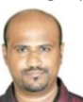
Mr.Vinod Kumar Allam
A globally recognized Cybersecurity Assurance Evangelist, Vinodh A holds over 19 years of experience architecting, developing and securing web-based software systems. As Practice Partner at Wipro Limited
Vinodh has trained thousands of individuals from leading Fortune 500 companies around the world on topics centered around secure web development. He holds a Master of Business Administration degree with specialization in Systems from Institute of Technology and Management

Slide 11


